Slide 1


Welcome to
Linewize Pulse

Slide 2


How to use these slides?
Contained within this slide deck are introductory presentations for students and staff
Students: Slides 3 - 15
Staff: Slides 16 - 29
Feel free to use these slides to introduce the program within your school community, including the relevant information for your school such as when you’ll be checking in, and who will be involved with Pulse
We have also included a template you can use to share Pulse insights with your school community. We highly recommend using this, or another method, of sharing insights with your school community to share the value of using Pulse.
Pulse Wellbeing Insights Template: Slides 30 - 32

Slide 3
Welcome to Linewize Pulse
Introduction for Students
Notes:
Today we are going to explore a wellbeing check-in program called Pulse. As we know, your wellbeing can change all the time. It is influenced by what’s happening in a specific moment and the actions you take.

Slide 4

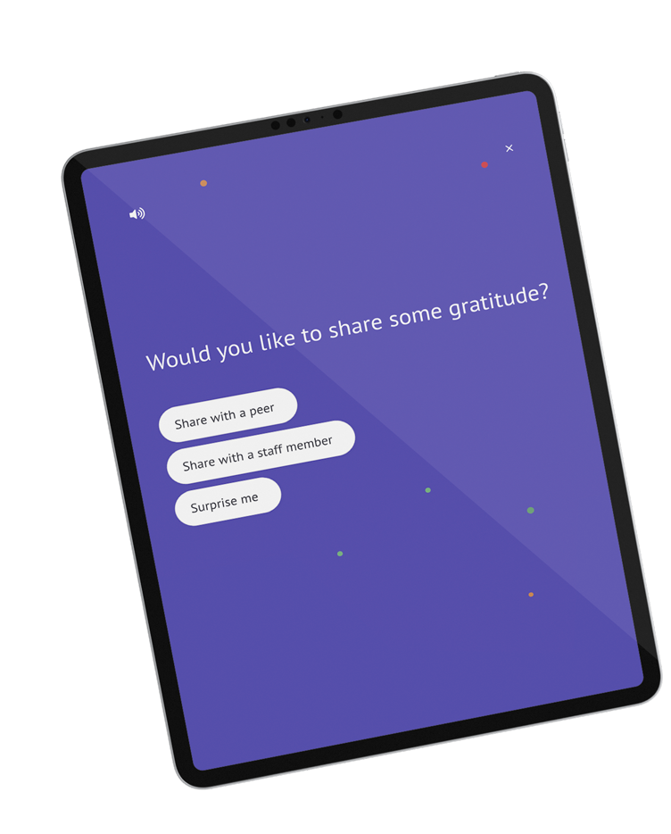
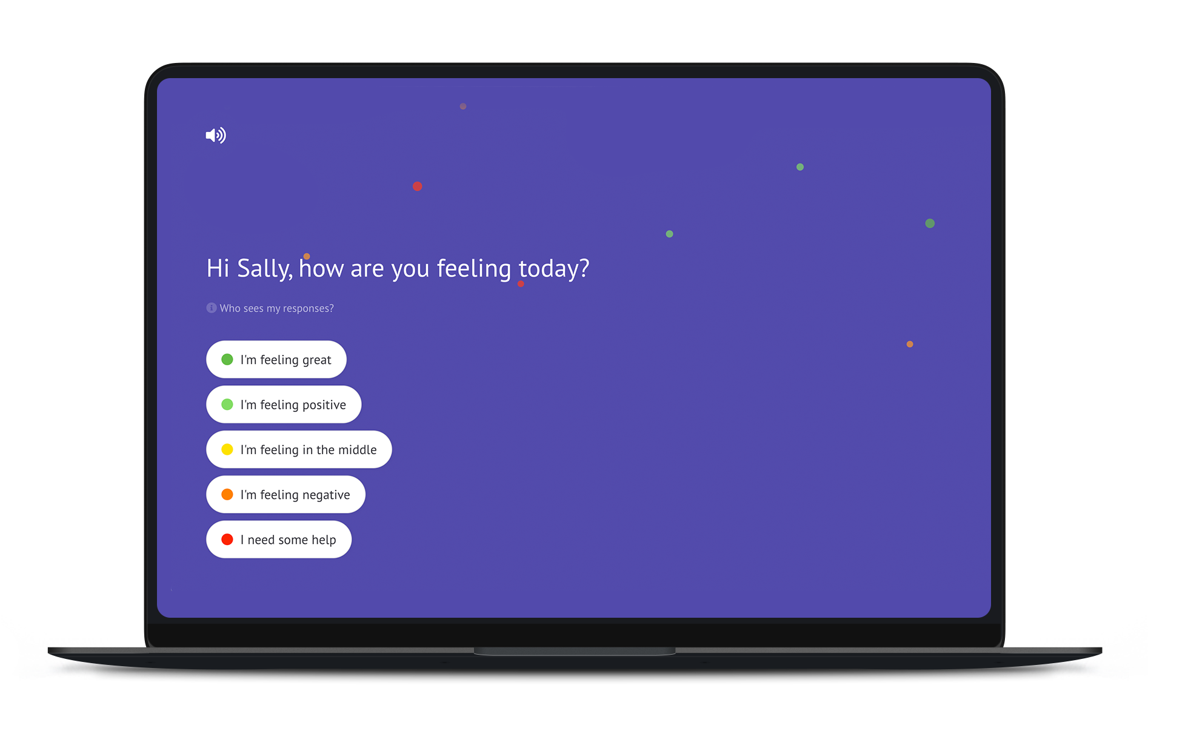
What is Pulse?
Pulse is an app you can use to check in with
your mental, social and physical wellbeing.
It takes 1-2 minutes, once a week
You can reflect on your wellbeing that week
You can reach out for help
You can send thanks to staff or peers
You can give anonymous feedback about your experience at school
Notes:
Pulse is an app you can use to check in with your wellbeing. It’s quick and easy to complete check-ins using Pulse. You’ll be asked a handful of questions, and have the chance to share thanks with a friend or staff member. You can also connect with wellbeing support, if you’re having a tough week

Slide 5
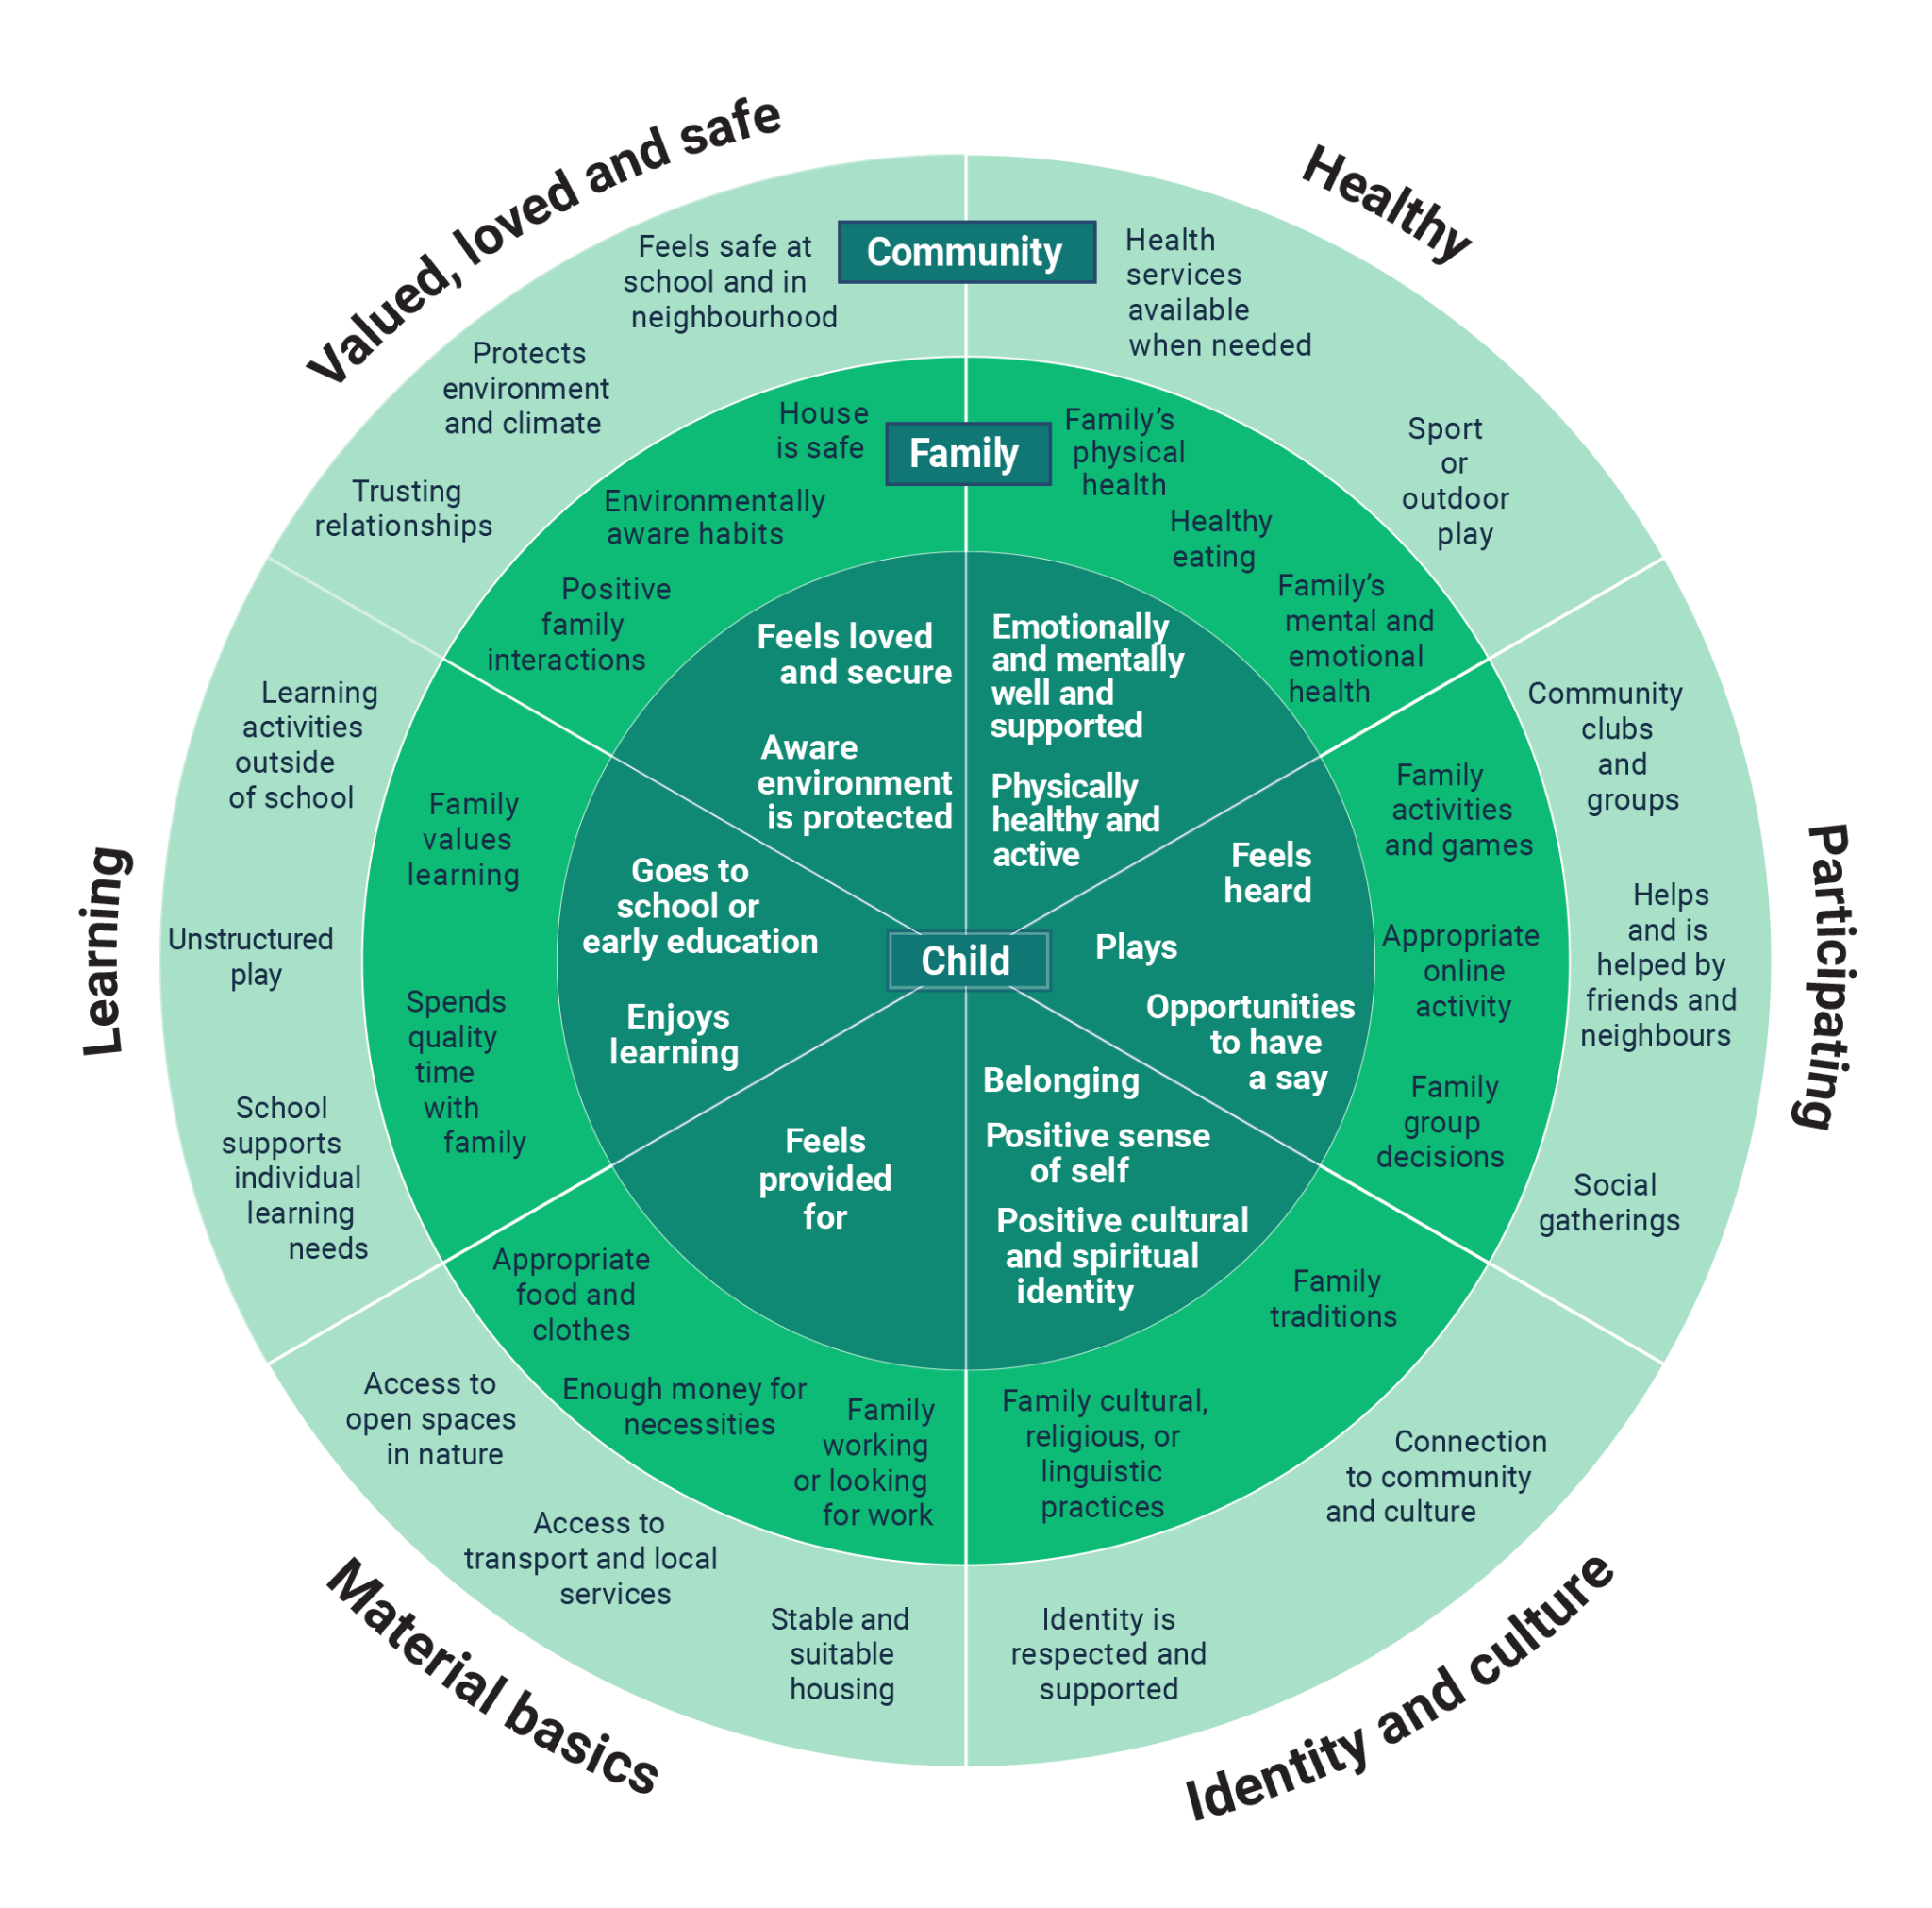
What are we Measuring?
Pulse uses an evidence based, research informed framework that conceptualises wellbeing as six interconnected domains that support each other to help children reach their potential.
To have optimal wellbeing, a child or young person needs to be adequately resourced in all six domains.
Notes:
Wellbeing is a cover all term that encompasses many facets of our life. It’s important to recognize that to have optimal wellbeing, we need to be adequately resourced in all six areas shown on this framework. These are the areas that will be measured by Pulse.
Healthy: The overall physical, mental and emotional health you experience
Material Basics are the basic necessities like clean water, enough food and someone to live.
We measure how valued and safe you feel
Participating: How much you participate in the activities and relationships around you.
Learning: refers to how well the way you learn is catered for
Positive Sense of Culture and Identity: is how much you feel that you belong within the school academic and social environment

Slide 6
Let’s start with the wellbeing questions
The first question is ‘How are you feeling today?’, followed by ‘Which of these best describes how you are feeling?’
Notes:
The first two questions are related to your overall wellbeing. You’ll first be asked ‘How are you feeling today?’, before being asked to dig a little deeper, and share an emotion you are feeling. These questions are identifiable, so your teachers will be able to see how you have responded to this question. You are always able to connect with wellbeing support in response to this question by selecting ‘I need some help’

Slide 7
What Happens if you Ask for Help?
You can choose who you would like to speak to
That staff member will be notified by email
They will approach you discreetly
Notes:
If you choose the option that says I need some help, you will be given a choice of who you would like to speak to at your school. They will then be notified by email and will approach you discreetly.

Slide 8
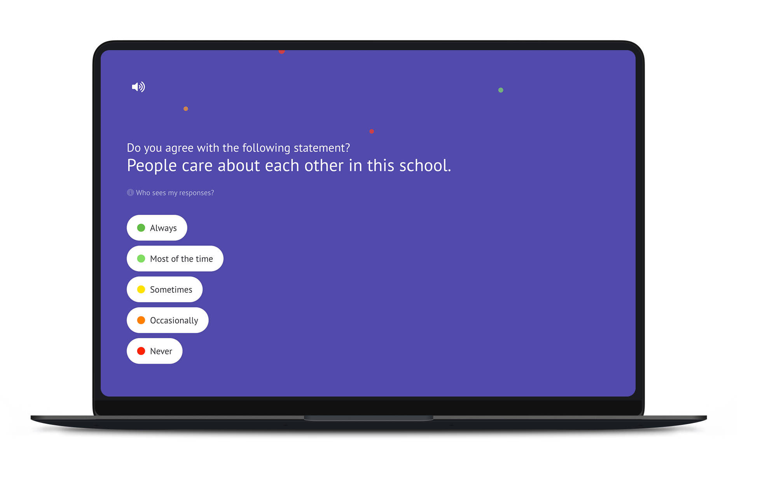
Up next, we evaluate sentiment and experience
Once you have answered the wellbeing questions, you will answer five anonymous sentiment and experience questions
Notes:
Once you have answered the wellbeing question, you will answer five anonymous questions such as the one on the screen. This is to give the staff at your school an feedback about how you are tracking as a group, and to give them ideas about where they can make changes, or build upon what’s going well. Remember, this feedback is all anonymous, so you can feel free to to answer all the questions truthfully.

Slide 9
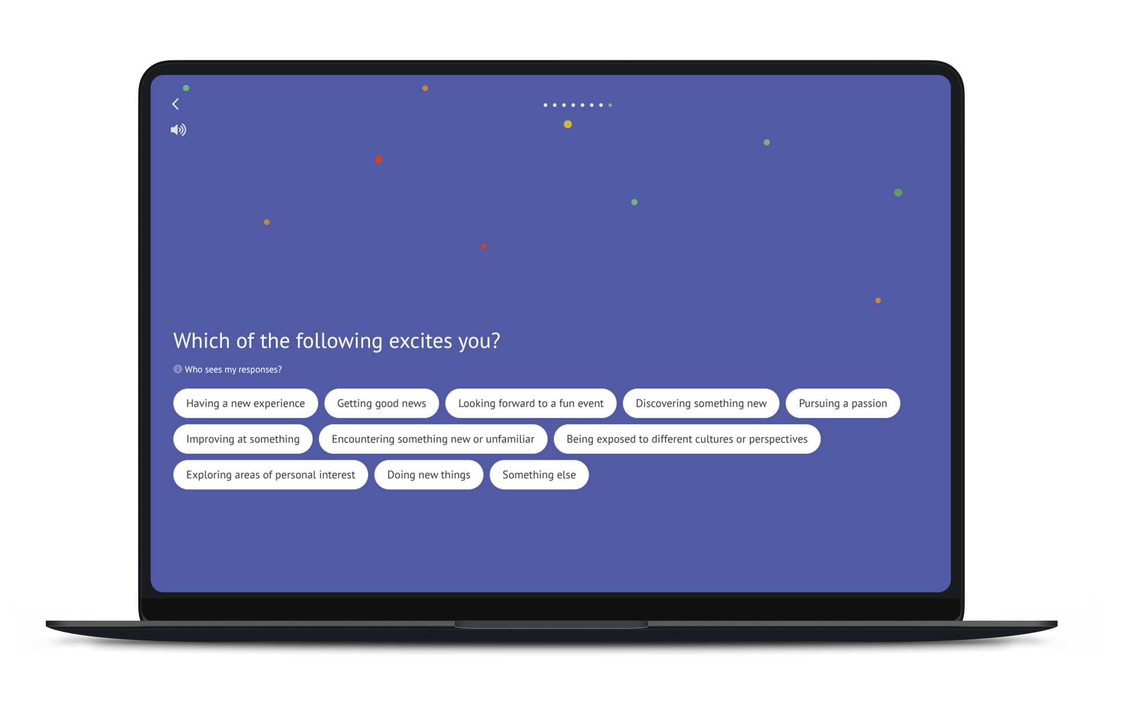
We then personally reflect
on something that makes us excited, happy, or relaxed
Before you finish the main part of the check-in, you’ll be asked what makes you excited, happy, or relaxed
Notes:
Before you finish the main part of the check-in, you’ll be asked what makes you excited, happy, or relaxed. This question is for your own personal reflection, and won’t be shared with school staff.

Slide 10
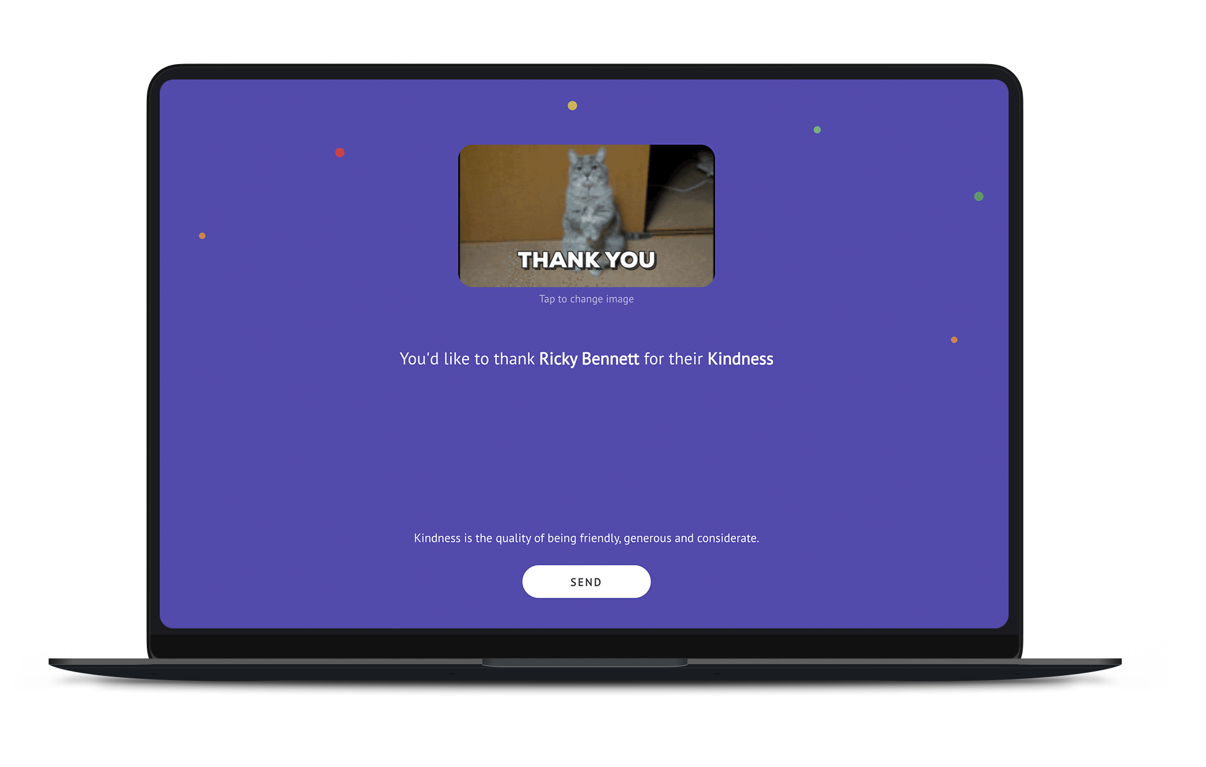
And we end with gratitude
At the end of the check-in, you will have the opportunity to practice gratitude.
Notes:
At the end of the check-in, you’ll have the opportunity to practice gratitude in two ways - first by thinking about something you are grateful for that week, and then by sharing some gratitude with a friend or staff member.
When sharing gratitude, the person you pick will get an email they have been recognised. You’ll be able to see gratitude you have received at the end of your check-in with the gratitude cards. I can tell you that all the research shows how beneficial it is for both yourself and the person you give gratitude to, so I strongly encourage you to give it a go.

Slide 11
Why bother?
Notes:
I can imagine that some of you are thinking to yourselves that this just going to be another thing to worry about. You do have to remember though, that it’s just about a minute of your time, once a week. It’s not much in the scheme of things, especially when there are such clear benefits.

Slide 12
Pulse Helps You To …
Self-Reflect
Connect With Support
Have a Voice
Notes:
Pulse gives you a safe way to ask for help if you need it, as well as a new way to make your voice heard and give your opinion about your experience at school.
As staff, we are going to take the information we gather seriously in order to make meaningful changes where necessary. Don’t forget, you can always ask your teachers to share what actions are being taken as a result of the feedback you are giving.
It also gives you the opportunity to take some time out on your week, and reflect on how you are going. Our wellbeing is always changing based on lots of different things, so it is a healthy practice to check-in on how we are going week to week.

Slide 13
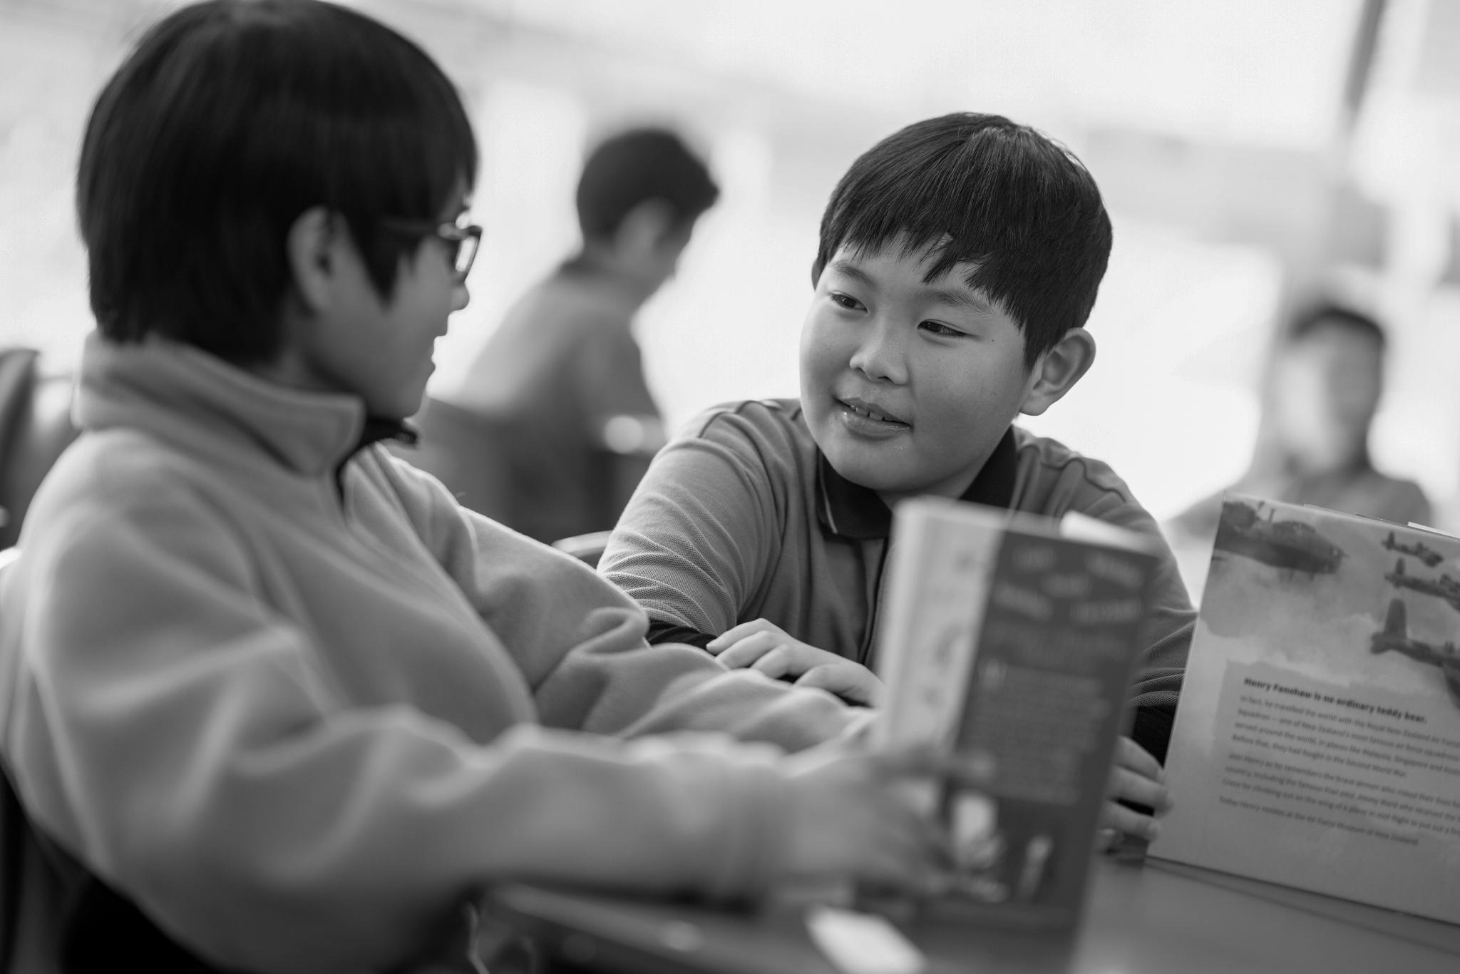
How will Pulse work at our school?
When will I be expected to complete my Pulse check- ins?
How often will staff at my school review the data?
How will the data be shared with us, the students?
linewize.com
Notes:
[Answer these questions with the information for your school]

Slide 14



In groups, consider and discuss:
What would you like to happen if you check in negatively more than once in a row?
We are going to celebrate positive check ins as well as support negative check ins. How would you like to do this (gratitude wall, share with a peer what is going well, etc)
We will share the information we are gathering about your experiences at school. How would you like to share your ideas about what we can do to address the issues (e.g. brainstorm on a whiteboard, send email ideas, talk about it in class etc)

Slide 15

Thank you

Slide 16
Welcome to Linewize Pulse
Introduction for Staff
Notes:
Today we are going to explore a wellbeing measurement program called Pulse. As we know, students' wellbeing can change moment to moment and is influenced by what’s happening at a specific time and the actions they take.

Slide 17
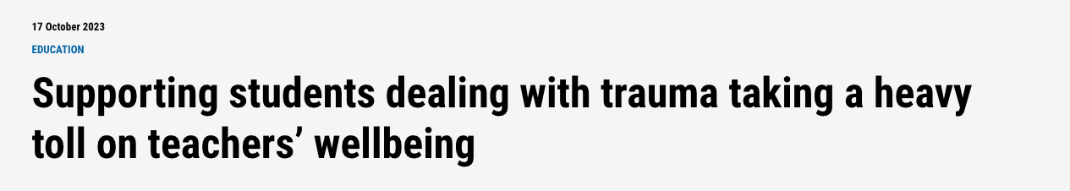

Physical, Mental Health and Digital Risks
Notes:
As teachers, we are aware that our students are facing risks every day, whether they be physical, mental health or digital.

Slide 18
Check-In on Your Students
Fun and easy weekly check-ins encourage students to reflect on their mental, social, and physical wellbeing by answering evidence-based questions.
During each check-in, students are asked randomised evidence-based questions, starting with a simple yet crucial question, “How are you feeling today?”.
Notes:
Pulse is an app which the students will use to check in with their wellbeing in 60 seconds, once a week. During each check-in, students are asked a range of questions, starting with a simple yet crucial question, “How are you feeling today?”.

Slide 19



Why Pulse
Works
Enable students to seek help
Identify at risk students early to avoid falling through the cracks
Save time by focusing on what matters most
Amplify student voice
Proactive intervention
Measure school climate
Notes:
So what makes Pulse different?
Students are able to seek help. When they check in they do so on a spectrum. They can state that they are feeling great, through to struggling. If they click ‘I need some help’, they will be given options for who they might like to speak to.
The weekly check ins allow you to identify at risk students early, to avoid them falling through the cracks. This isn’t a case of checking in once a year and maybe looking at the data three months later. This is real time, which gives you control.
You’re saving time by focusing on what matters the most. you’re not speculating and hoping for the best.
Pulse amplifies student voice. not only can they check in on an individual basis to tell how they’re going, they can also give feedback as a collective, which means you can make proactive intervention with an accurate read of the school climate, to make sure the school is the right sort of environment for both students and staff
Pulse supports a positive school culture, through giving students and staff the opportunity to share gratitude with those around them

Slide 20
How Linewize Pulse Helps Staff
What does it really mean for staff?
1
2
3
4
Student Voice - From the individual to collective level, students are given the opportunity to give feedback or reach out for help
Relationships - Another tool in your kit to form deep connections with your students
Trust - Action the data and show students that you mean what you say
Empowerment - Understanding what students need and being given the tools to deliver it
Notes:
What does this really mean for staff? How does it help you?
Importantly, Pulse gives your students a voice. From the individual to collective level, students are given the opportunity to give feedback or reach out for help.
In turn, you are able to form closer relationships with your students with this, another tool in your kit to form deep connections. You’ve now got the information at hand to be able to connect with your students about things that matter to them, or even just to check in with the answers to their wellbeing questions.This leads to empowerment. Understanding what students need and being given the tools to deliver it will make you feel that you have a handle on things, and that you’re not going to let important details slip through the cracks,
When you use this power, and take action to show you’ve listened, your students will trust you more than they did before. From here, the cycle continues and they are more motivated to speak up, which leads to closer connections and a much more fulfilling and meaningful role as an educator.

Slide 21

How Linewize Pulse Helps Students
Real-time insights
Connect with support
Student voice
Whole school data
Notes:
So why do we bother with this? Of course we are all very busy. However, there are clear benefits for both students and staff.
Pulse provides real time data so we are able to start gaining insight into their current wellbeing, and take action on that quickly
It provides students with a safe and discreet way to connect with wellbeing support when they need it
Pulse provides a powerful opportunity for student voice and agency
And lastly, Pulse provides a breakdown of data from the whole school level to year level, class and the individual, allowing us to address wellbeing successes and concerns more effectively

Slide 22
What are we Measuring?
Pulse uses an evidence based, research informed framework that conceptualises wellbeing as six interconnected domains that support each other to help children reach their potential.
To have optimal wellbeing, a child or young person needs to be adequately resourced in all six domains.
Notes:
Pulse uses an evidence based, research informed framework that conceptualises wellbeing as six interconnected domains that support each other to help children reach their potential. To have optimal wellbeing, a child or young person needs to be adequately resourced in all six domains.
Healthy: The overall physical, mental and emotional health of students.
Material Basics: The basic parts of life that contribute to an overall well-rounded individual.
Valued and Safe: How valued and safe a student feels.
Participating: How a student participates in the activities and relationships around them.
Learning: How a student learns.
Positive Sense of Culture and Identity: How a student feels they belong within the school academic and social environment and the expectation they perceive to be placed on them.

Slide 23
How does Pulse work?
It takes 1-2 minutes, once a week
Students will be asked two identified questions:
  How are you feeling today?
  Which of these best describes how you are feeling?
Students will be asked five sentiment and experience questions from the ARACY framework, which are anonymous
Students can reach out for help
Students can share gratitude with a peer or staff member
Notes:
Let’s take a look at the student check-in experience.

Slide 24
Take into Consideration
Most students will check-in in the time you set aside to do it each week, but will also be able to complete additional check-ins throughout the week.
When a student reaches out for help, the staff member they reach out to will receive an email notification and notification in Pulse
Students will receive an email prompting them to check in at the same time each week.
Students who have not completed a check-in for the week will also receive a reminder email.
When this second reminder email goes out, staff will receive an email reminder to login to the dashboard to check their student data.
Notes:
Most students will check-in in the time you set aside to do it each week, but will also be able to complete additional check-ins throughout the week. Students will receive an email prompting them to check in at the same time each week, and students who have not completed a check-in for the week will also receive a reminder email. You are able to set when you would like these reminders to be sent out.
When this reminder email goes out, staff will receive an email reminder to login to the dashboard to check their student data

Slide 25
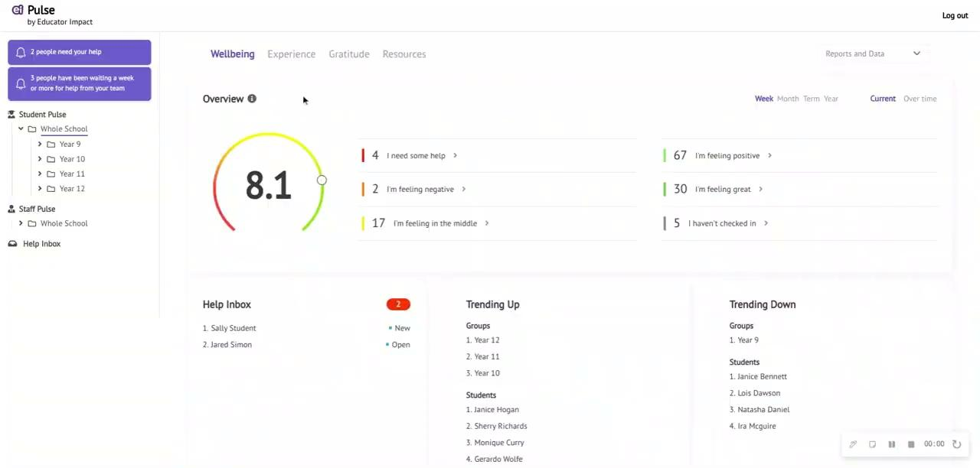
Navigating the Pulse Dashboard

Slide 26
If a student approaches you for help:
It is because they trust you.
Listen without asking too many questions at first or interrupting them.
Try to give them your full attention.
Try not to minimise their feelings, thoughts, or situation.
Try not to jump to conclusions or judge.
Thank the student for sharing with you, and acknowledge that you understand that it can be hard to ask for help:
“I can tell that asking me for help was really difficult for you. That was a brave thing to do. You’ve done the right thing. Let’s figure out what we can do as a next step.”
Encourage them to seek additional help if needed, or offer to go with them to see a school wellbeing team member.
*with thanks to Valorie O’Keefe, Consultant Psychologist at Pearson Clinical for these notes
Notes:
It is important to remember that you will speak to a student who has reached out through pulse in the same way you would if they had approached you in person after class.
It is because they trust you.
Listen without asking too many questions at first or interrupting them.
Try to give them your full attention.
Try not to minimise their feelings, thoughts, or situation.
Try not to jump to conclusions or judge.
Thank the student for sharing with you, and acknowledge that you understand that it can be hard to ask for help: “I can tell that asking me for help was really difficult for you.”“That was a brave thing to do. You’ve done the right thing. Let’s figure out what we can do as a next step.”
Encourage them to seek additional help if needed, or offer to go with them to see a school wellbeing team member.

Slide 27
Student Check-In
Pulse
User Flow Chart
Share findings with students
Share findings with staf
Review Data
Collect feedback re: Potential courses
of action
Collect feedback re: Potential courses
of action
Action Plan
Communicate
Notes:
Finally, here is an example of what best practice would look like for a school using Pulse.
Ideally students check in at the same time each week, in a classroom under supervision of the teacher. If staff pulse is used, this is a good time for the teacher to set an example and check in themselves.
Pulse directors are able to export both wellbeing and experience data. Wellbeing data should be accessed weekly, and all help requests or other concerns should be actioned promptly. Experience data can be reviewed less often, though ideally it should be at least monthly. From here, wellbeing leaders can identify trends.
Decide which (if not all) trends you would like to share with your students. Sharing the trends will show them that you are actioning the data and their check ins are meaningful.
Invite students to brainstorm and/or contact their teachers with ideas for how the school can action the data. This will make the experience meaningful and they will be more likely to engage with the app in an authentic way.
Share the trends with your staff at staff meetings,
At staff meetings, discuss the data and brainstorm initiatives that can address any issues that arise.
After collecting feedback on potential initiatives, wellbeing team members create an action plan to address any issues that have been illuminated through the review.
Communicate the action plan to all stakeholders (staff, students, broader community) and keep them up to date with developments.

Slide 28
In groups, consider and discuss:
What initiatives do you currently run to address the six different well being domains?
How will you react if a student comes to you for help?
Consider doing role plays to practise.
What does success look like for your school, or in your own classrooms? (What are you trying to achieve? What are your goals?)

Slide 29
Thank you

Slide 30
Pulse Wellbeing Insights
Template
Notes:
The next three slides can be used to help share Pulse insights at your school. You can see a sample in the next slide, then a blank template in the final slide where you can fill in your schools insights.

Slide 31
Week 1, 2024
Things we’re feeling good about
450 expressions of gratitude
90% of pupils asked chose green when asked about physical or verbal bullying
Things we need to work on
Less than half the pupils rated green for “Meeting expectations”
Things we did better on this week
For Perseverance, more pupils put green this week
Recommended resource
The Gratitude Playbook

Slide 32
Week 1, 2024
Things we’re feeling good about
Things we need to work on
Things we did better on this week
Recommended resource

